Slide 1
Lecture 5: Quality Assurance
SE for Startups
Michael Hilton

Slide 2
Administrivia
HW 3 Due Feb 13th
Weekly Status Report - use template on Github, submit link in Canvas. Due Tonight, should only take a few minutes

Slide 3
Quality Assurance

Slide 4
The best way to assure quality is a good process

Slide 5
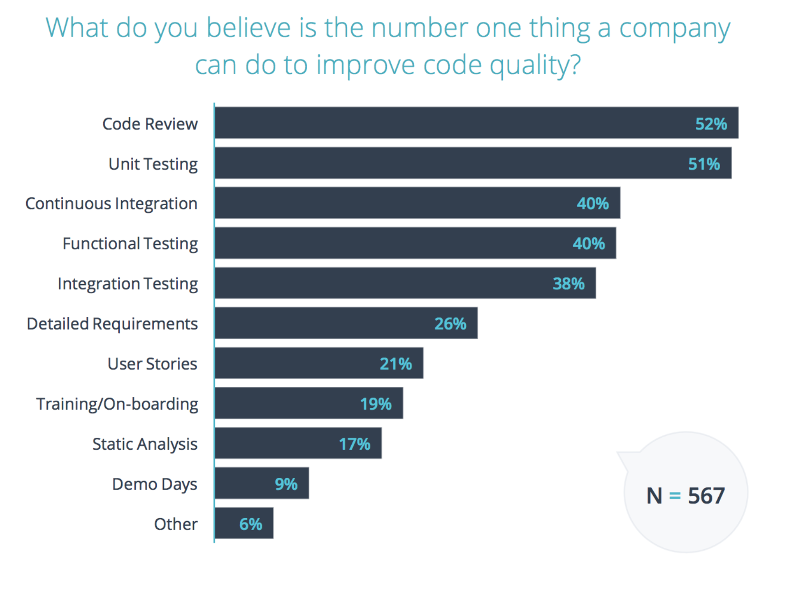
[State of Code Review 2017]

Slide 6
“Continuous Integration doesn’t get rid of bugs, but it does make them dramatically easier to find and remove.”
— Martin Fowler, Chief Scientist, ThoughtWorks

Slide 7
Testing tools must have tests to be valuable!!

Slide 8




History of Continuous Integration
(1999) Extreme Programming (XP) rule: “Integrate Often”
(2000) Martin Fowler posts “Continuous Integration” blog
(2001) First CI tool
(2005) Hudson/Jenkins
(2011) Travis CI

Slide 9





Sample CI Workflow (Github + Travis)
Create Pull Request
GitHub tells Travis CI build is mergeable
It builds and passes tests
Travis updates PR
PR is merged

Slide 10
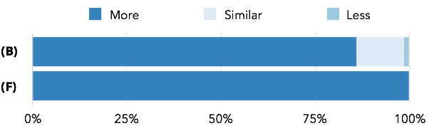
Developers Say:
Do developers on projects with CI give (more/similar/less) value to automated tests?
(B)road (F)ocused

Slide 11
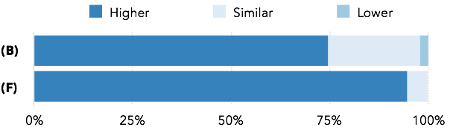
Developers Say:
Do projects with CI have (higher/similar/lower) test quality?
(B)road (F)ocused

Slide 12
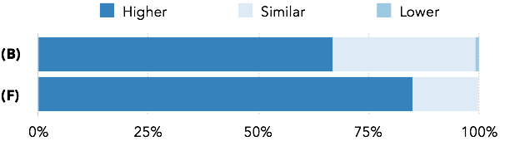
Developers Say:
Do projects with CI have (higher/similar/lower) code quality?
(B)road (F)ocused

Slide 13
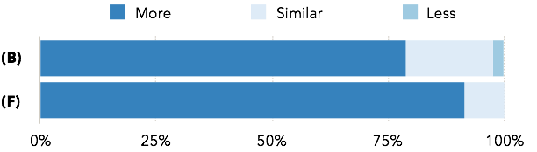
Developers Say:
Are developers on projects with CI (more/similar/less) productive?
(B)road (F)ocused

Slide 14
Conflicts:
Information Security
Flexibility
Speed
Simplicity
Certainty
Access

Slide 15
Implications
Write tests that provide value
Spend time to maintain your tests, improve quality, remove unneeded tests
Balance rigorousness of the test suite with speed of running tests
Follow security best practices
Consider long term costs of complex, custom workflows

Slide 16
Observation
Most of the benefits of CI come from running tests

Slide 17
Test Driven Development (TDD)
Three Simple Rules
You are not allowed to write any production code unless it is to make a failing unit test pass.
You are not allowed to write any more of a unit test than is sufficient to fail; and compilation failures are failures.
You are not allowed to write any more production code than is sufficient to pass the one failing unit test.

Slide 18
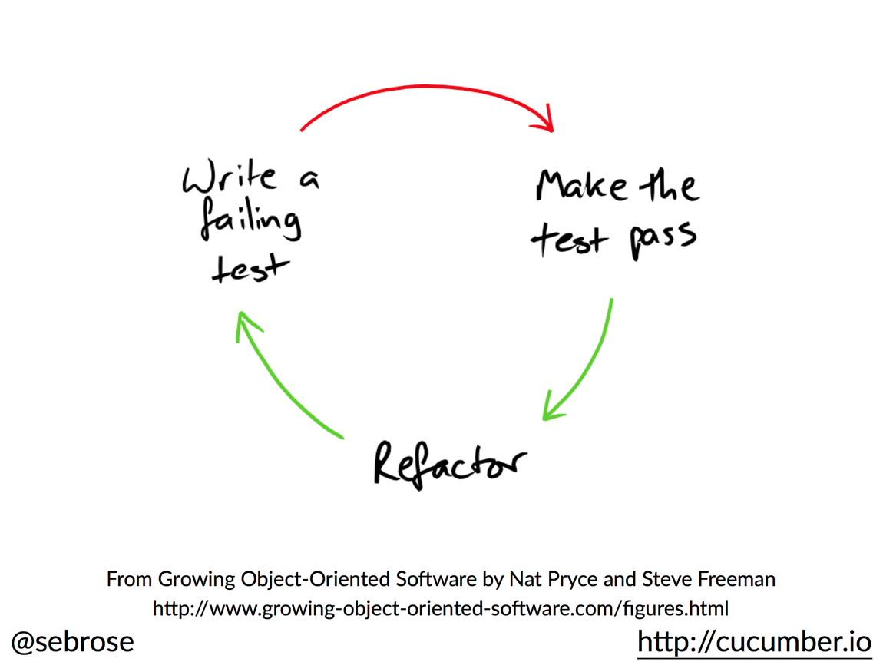
Test Driven Development (TDD)

Slide 19
Why TDD
“The act of writing a unit test is more an act of design than of verification.
It is also more an act of documentation than of verification.
The act of writing a unit test closes a remarkable number of feedback loops, the least of which is the one pertaining to verification of function”.

Slide 20
Advantages of TDD
Clear place to start
Much less code thrown away, less wasted effort
Less Fear
Side Effect: Robust test suite

Slide 21
TDD Demo

Slide 22
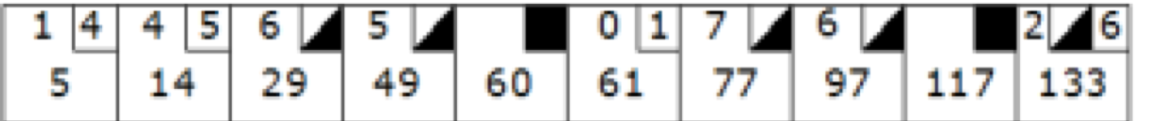
Scoring Bowling.
10 frames, 2 rolls per frame. Frame score = sum of rolls.
A spare is when all 10 pins are knocked down in two rolls, the next roll is added as a bonus
A strike is when all 10 pins are knocked down in one roll, the next two rolls are added as a bonus.

